Slide 1


ELISA Workshop London, UK
June 9-11, 2026
Co-hosted with Canonical

Slide 2
Functional Safety with Xen, Zephyr, and Linux for Avionics, Automotive and Industrial [Matthew Weber, Ayan Kumar Halder]
ELISA Workshop: London, UK
June 9-11, 2026
Co-hosted with Canonical

Slide 3
The flow
Why use a hypervisor?
Key features of Xen which makes it useful for safety critical system
How Xen shares responsibility with Linux and Zephyr to enable a safety system
It all begins with requirements
Describing the features that Xen provides to the domain - in our case market requirements
The flow from market to product to SSR
Why AoUs and the key AoUs
Why Arch spec
How do you verify and validate a complex system?
The various kinds of tests - req based tests, BVA, fault injection, runtime
The tooling around - MCDC coverage
Further splitting the requirements to tie them to functions - making DO
The Big question - evergreen certifiability - upstream, maintain
So Join us - Xen Project, Xen Safety Committee

Slide 4
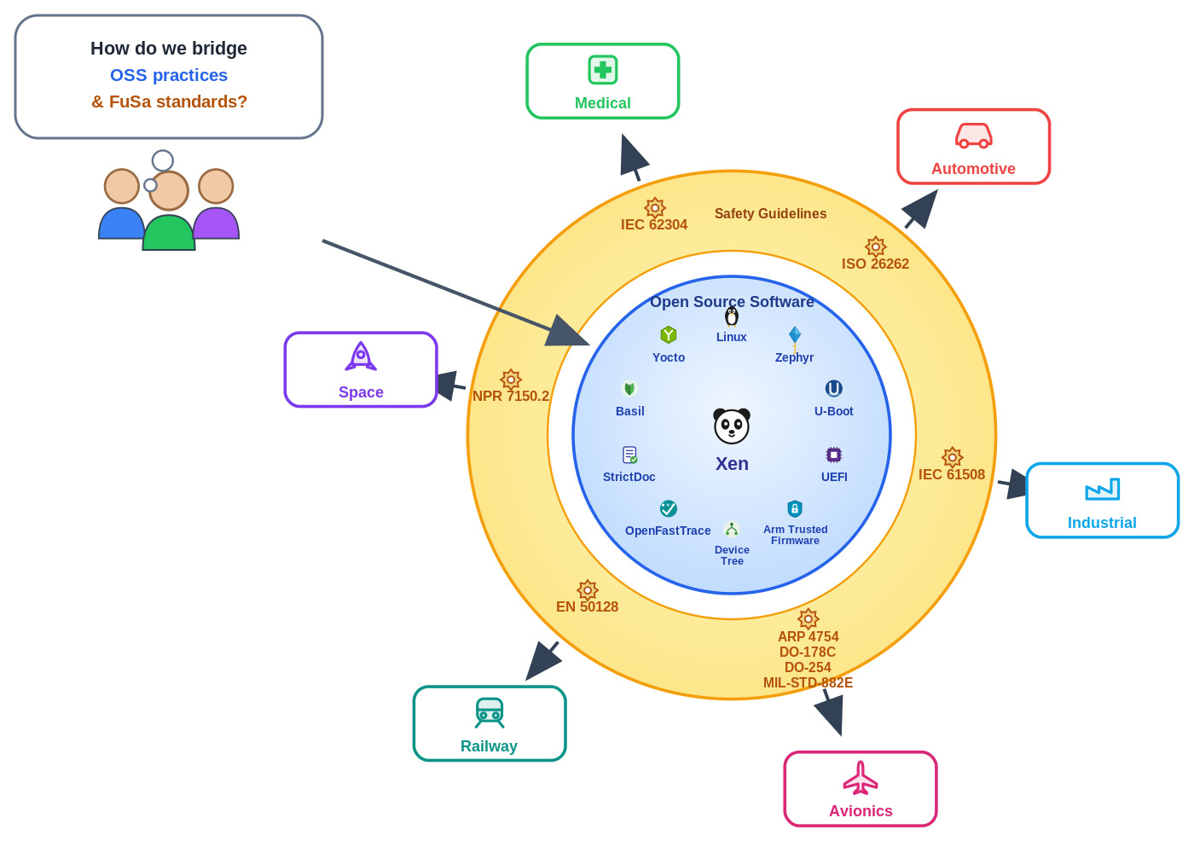
Our shared vision - OSS meets FuSa
Notes:
Change the position of guidelines, ARP 4754, DO-178C, DO-254 —-> Avionics ISO 26262 —-> automotive NASA standard → space

Slide 5
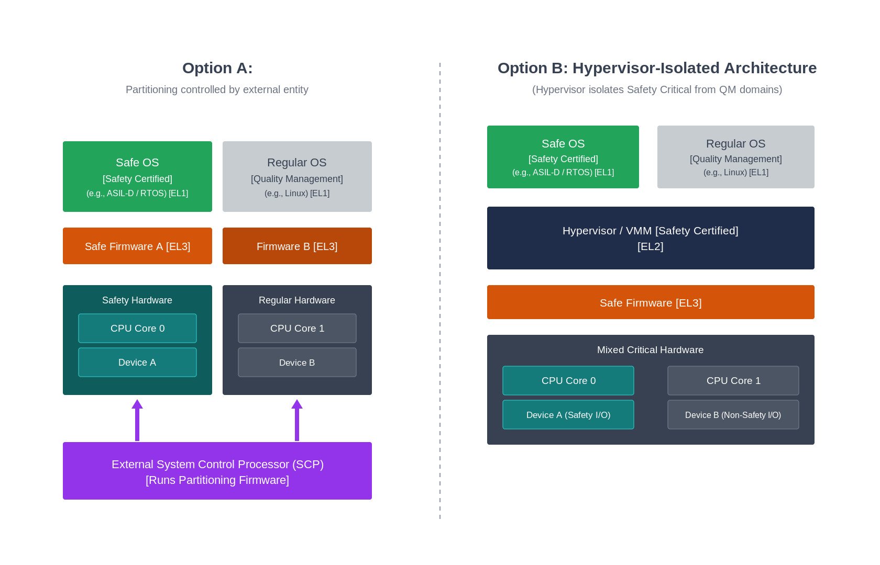
Safety certification approach - Need for hypervisor

Slide 6
Key Features of Xen for safety certification
Type1 hypervisor (Or Baremetal Hypervisor)
Xen manages few hardware resources like Interrupt controller, IOMMU, Timer, UART, MMU
Partitioning of CPU cores, memory and hardware resources to VMs. Ensures that the other VM will not have access to the device and memory
Xen can create and boot domains in parallel (Hyperlaunch). There is no dependency on Dom0 for FuSa VMs
Supports Arm safety cores and IPs: Cortex-A720AE, GIC-600AE, MMU-600AE
App1
App2
App1
App1
EL0
VM/domain1
VM/domainn
EL1
Safety certified Xen
EL2
Firmware
EL3
Hardware

Slide 7
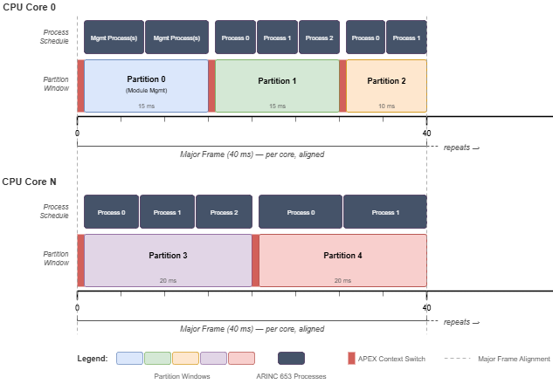
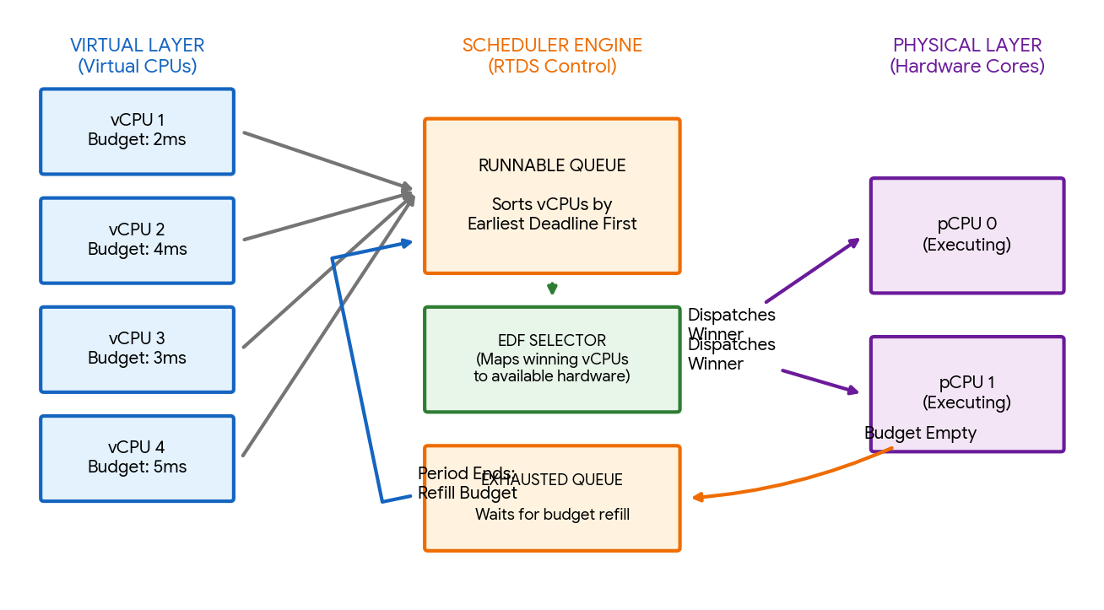
Different Schedulers supported - Time partitioning
NULL – static pinning
ARINC653
pCPU
pCPU
vCPU
vCPU
RTDS
(Partition == Domain)
Credit2
pCPU
pCPU
vCPU
vCPU
vCPU
vCPU
Notes:
RTDS – a static table defining the time budget , ARINC 653 is similar to RTDS

Slide 8
Xen relies on Domains to manage the system
Control domain
Regular domains
Can be assigned one or more hardware
suspend/resume, pause/unpause,
Shutdown/restart
Impacts the platform
*Default owner of the platform unless a device is assigned to another domain
Hardware domain
Platform specific operations
The control domain can be a safety cert RTOS like Zephyr
The hardware domain can be a rich OS which supports many drivers like Linux
Untargetable
Regular domains

Slide 9
Xen with Zephyr and Linux as VMs
Preferably safety cert RTOS. Very minimal functionality
A rich OS which has support for many drivers
Minimal OS which can be interrupted by other domains
Minimal OS which cannot be interrupted by other domains
There can be 0-1 control domain and/or 0-1 hardware domain and/or 0-N targetable/untargetable domains
Xen supports both static mapped domains created at boot time and dynamic domain created at run time.
Control domain - Zephyr
Hardware domain - Linux
Targetable regular domain – Zephyr
Untargetable regular domain - Zephyr
Safety certified Xen – ASIL D / SIL3
Arm Trusted Firmware
Hardware
Notes:
Do not go into detail Targetable , untargetable , just explain the concept , key takeaway the concept of privilege to explain safety vs non safety

Slide 10
Assumptions on domains
Control domain
Has the toolstack to create/destroy domains at runtime.
Can run privileged operations to impact other domains (via mapping memory, etc)
Should be untargetable
Hardware domain
Can be a part of control domain (ie dom0) or separate.
Able to support all the platform devices
Can run device emulation (backend)
Should be targetable
Regular domain
Can be assigned one or more platform devices.
Can share devices using PV or VirtIO with other domains.
Can be targetable (for PV/VirtIO) or untargetable

Slide 11
FUSA hardening with MISRA, DCE
Directives 1.1, 2.1, 4.1, 4.7, 4.10, 4.11, 4.14 adopted
120 MISRA C rules adopted
https://gitlab.com/xen-project/xen/-/blob/staging/docs/misra/rules.rst?ref_type=heads
ÉCLAIR MISRA C scanner used in upstream CI loop.
Every patch submission goes through the MISRA C scans to avoid regressions.
C language extensions and the assumptions on the toolchain (GCC) are documented
Dead code elimination using granular KConfig, compiler nuances (constant conditionals) and VRP
The aim is to ensure the minimal footprint of Xen for the specific platform while making the code configurable to support as wide range of platforms
Enables upstreaming and common code between FuSa & non FuSa players
Refer “[PATCH v2] xen: gic-v3: Introduce CONFIG_GICV3_NR_LRS
” on xen-devel

Slide 12
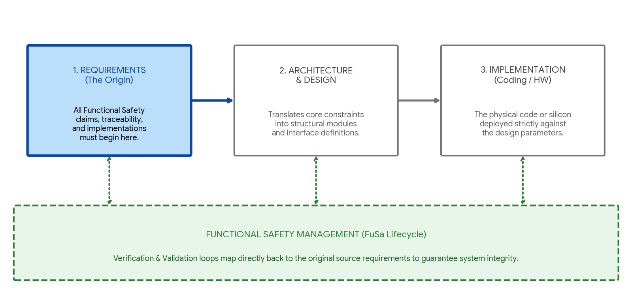
It all begins with requirements
*Code exists and drives requirements (IEC61508 Route 3S “Reuse”)
*

Slide 13
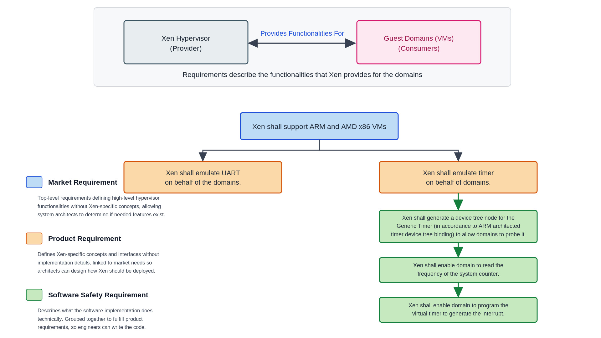
How do we define requirements in Xen

Slide 14
Organizing the software safety requirements
Domain Creation
Domain Firmware
Booting
Domain Fully Emulated
Instruction emulation
Firmware
Domain Exposed
Xen Internals
Domain Partially Emulated
Physical resources
Physical resources
Hypercall
Scheduling
FFI
https://gitlab.com/xen-project/xen/-/tree/staging/docs/fusa?ref_type=heads https://gitlab.com/xen-project/fusa/requirements

Slide 15
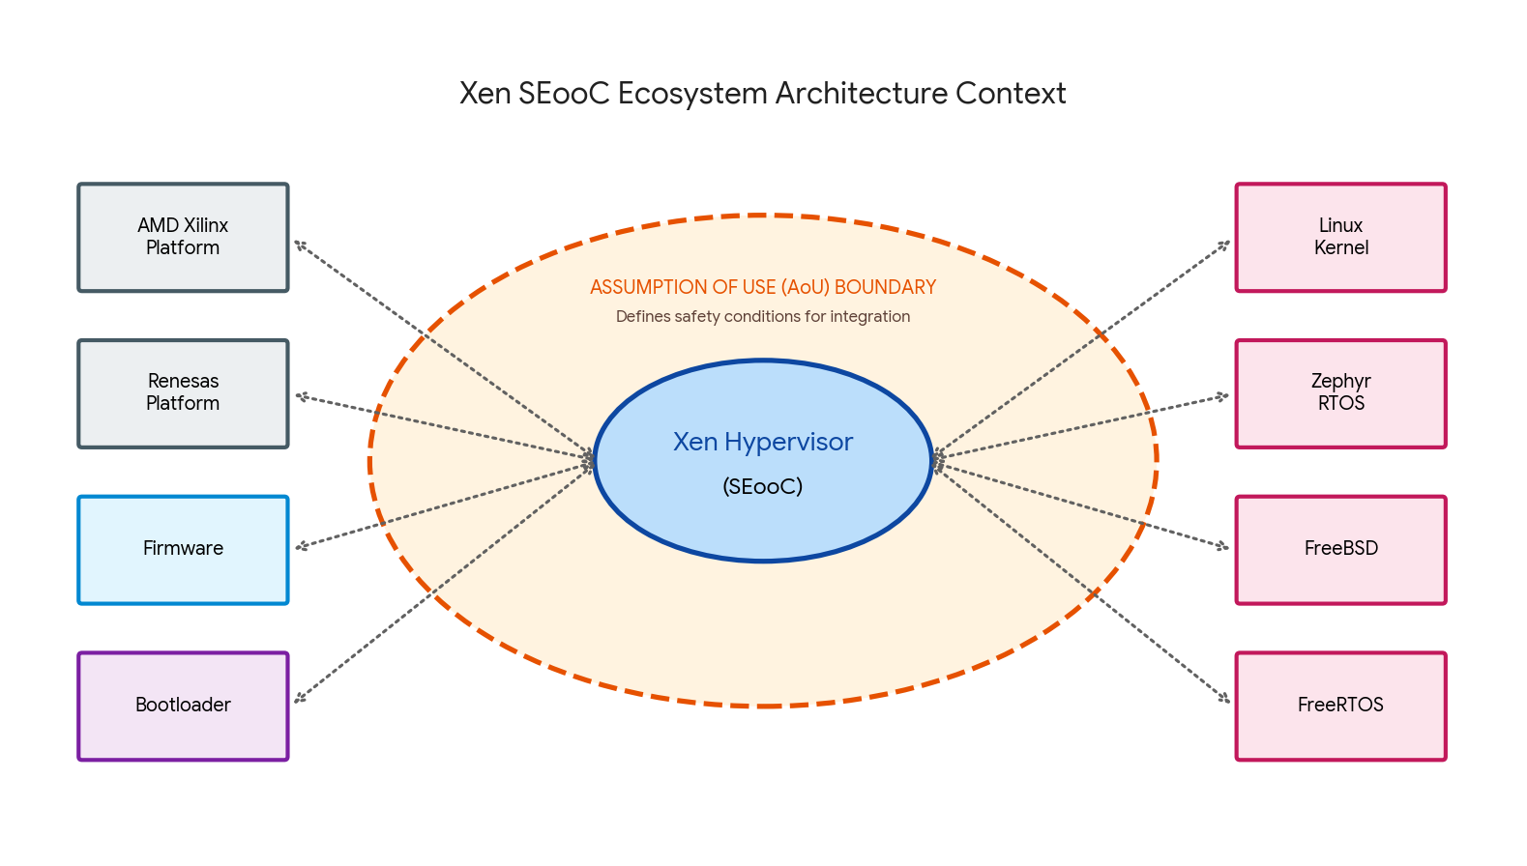
Remember Xen is SEooC
(Safety Element out of Context)

Slide 16
Assumption of Use
The hardware needs to have the ARM Generic Interrupt Controller, version 3
The hardware needs to have the Arm System Memory Management Unit, version 3 onwards
Hardware
GCC version shall be 5.1 or later (arm64)
GCC version shall be 4.1.2_20070115 or later (x86)
Arm Compiler for Embedded FuSa (based on LLVM 22.1)
CNTFRQ_EL0 needs to be programmed with the system timer frequency. Or the "clock-frequency" dt property should be used.
TF-A shall provide PSCI api (PSCI_VERSION) to read the version.
Compiler
Firmware
Xen relies on them to fulfill its functionality
Domain shall not write access GICD_ISACTIVER<n> registers
Domain shall not use physical LPIs without ITS
Xen shall be loaded at Non-Secure EL2 exception level.
Bootloader shall pass physical address of the host device tree in x0 register.
DDR shall be initialized, DMA devices shall be stopped
Domain
Bootloader
Notes:
Artem to add safety compiler

Slide 17
Example: Key Assumption of Use on Domains
On Zephyr as safety critical domain – It should mask its event channel notifications during the safety critical task to avoid being interrupted by other domains
On Linux as QM domain – It shall enable the platform devices and perform platform operations (suspend, power off, reset, reboot) only when requested by the control domain.
It shall enable the PV.VirtIO backend drivers to perform device emulation

Slide 18
Architecture and Design
Notes:
Highlight the “Architecture & Design”

Slide 19
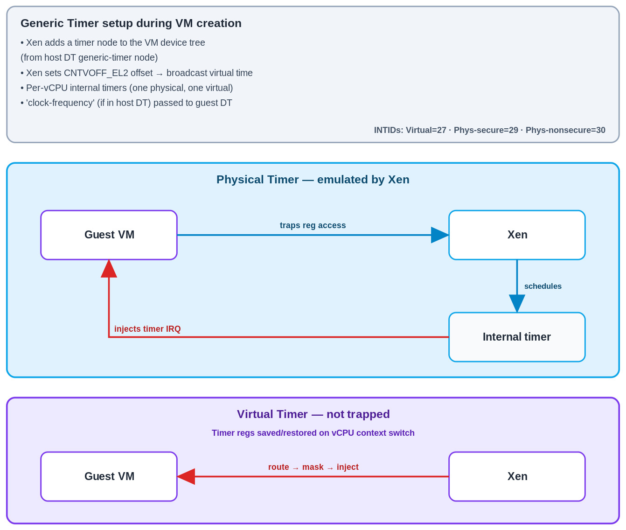
Architecture Spec
While requirements describe the features that Xen provides, architecture spec describes how the feature is implemented, interfaces to the other architectural components, error propagation, data/control flow, etc
Architecture Spec is linked to a set SSRs belonging to a component
By linking SSRs to Arch spec , we avoid putting any markers in the code (and thereby ensure the code is clean).
https://gitlab.com/xen-project/fusa/architecture_specs/-/blob/master/domain_creation_and_runtime/domain_partially_emulated_resources/arm64/generic_timer.rst

Slide 20
How do you verify and validate a complex system?
Notes:
Remove the highlighting from “Requirements”

Slide 21
Overall Testing deployment
Fuzz
Domain based validation tests or domain/Xen interface tests
Domain based validation tests or domain/Xen interface tests
Domain based fault injection tests to Xen or negative tests
Runtime tests/ memory stress tests
FFI tests
Internal interface tests
Xen ASIL D (SEooC)
Mem alloc
Scheduler
Trap handler
Xen/Bootloader/Firmware interface tests
Xen/hardware interface tests
DTB/Firmware/Bootloader fault injection tests
Hardware based fault injection
Qemu/Hardware
Notes:
We do domain based tests and software in the loop (using Qemu) test

Slide 22
Domain based Tests/SSR tests/Xen domain interface
Domain based tests are used to verify the blackbox requirements or perform fault injection from domain
For eg - Xen shall support transmission of data in polling mode for the domain.
Pros - Xen is unmodified. It is tested in the way it will be used in production.
Cons - The tests are relatively high level. They can test a lot of code together.
Emulated UART
Trap/Exception
handler
Linux/Zephyr/XTF as domain
with UART driver and application
Xen
Notes:
Walkthrough with an actual example a domain based test

Slide 23
Xen/HW interface Test
The test aims to validate Xen’s configuration of the hardware. For eg Xen’s GICv3 driver should be able to generate software generated interrupt
For this, we introduce self tests within Xen.
https://gitlab.com/xen-project/fusa/test_specifications/-/blob/master/hw_sw_interface/test0_sgi_gicv3.rst
https://lists.xenproject.org/archives/html/xen-devel/2025-09/msg00956.html
Xen
GICv3 driver
GICv3 Test
The test can be compiled out in the production build
The test runs during boot time
Notes:
Walkthrough the slides

Slide 24
GDB based tests for internal interface
Xen has lots of internal components which invoke one other. We need a way to test the interface between the components. Also, we need a way to inspect the internal data structure and mock the error handling paths.
Use GDB to validate the internal data structures or the interface between different arch components
https://gitlab.com/xen-project/fusa/test_specifications/-/blob/master/domain_creation_and_runtime/scheduling/test_sched_core_halt_on_scheduler_failure.rst
Xen
Credit2 scheduler
Core scheduler subsystem
GDB to inspect return values and modify to simulate failures
Notes:
Walkthrough

Slide 25
Hardware Fault Injection using Qemu
Using Qemu testing framework
Xen
GICv3 driver
Xen panics
Inject fault
Qemu
QTest
GICv3 hardware
Qemu can emulate most of the hardware faults which are observed by Xen
It emulates many of AE IPs which have test registers

Slide 26
Software fault injection/negative tests
Using domains, device tree binaries, etc
Xen
Invokes hypercall with incorrect params or performs an illegal action
Domain
Returns error or takes appropriate action
Xen
Some of the fault injection tests are derived from boundary value analysis/equivalence class partition of hypercall parameters
Xen stops booting
Improper HW configuration in device tree

Slide 27
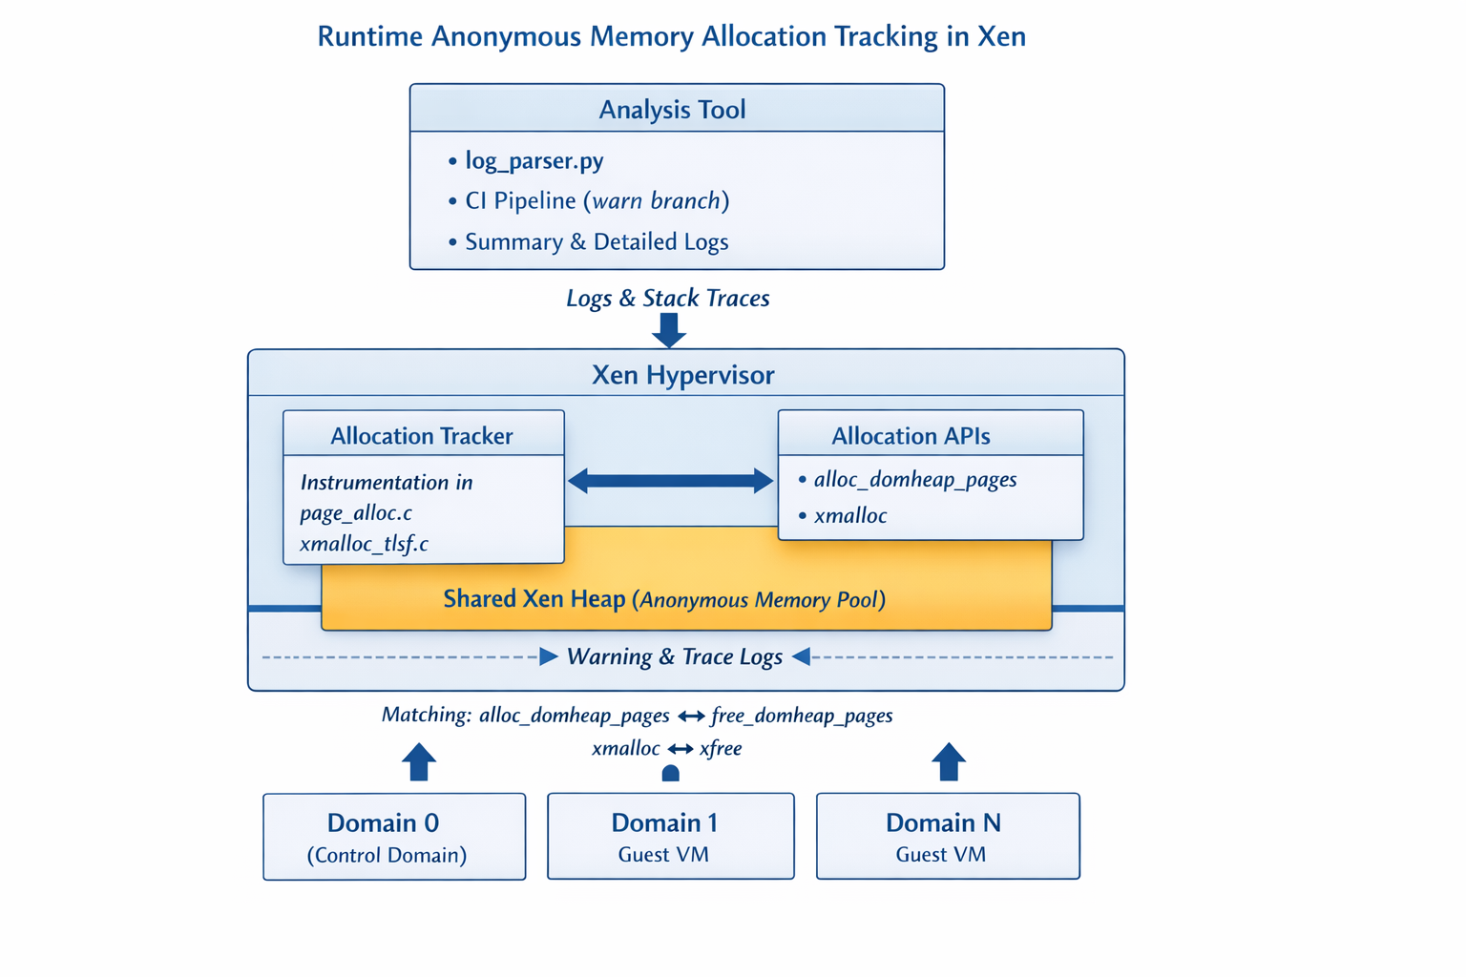
Runtime tests
Minimise the runtime memory allocation. To prevent Xen from running out of memory
Xen has a shared heap → source of anonymous allocations
Domains (d0, d1, …) trigger allocations indirectly via Xen
Tool instruments core allocators (TLSF + page allocator)
Runtime → after SYS_STATE_active (post-boot steady state)
Output → logs + stack traces + domain attribution + matching frees
https://gitlab.com/minervasys/public/xen/-/blob/minerva/warn/minerva_analysis/README.md
Notes:
Move after conclusion

Slide 28
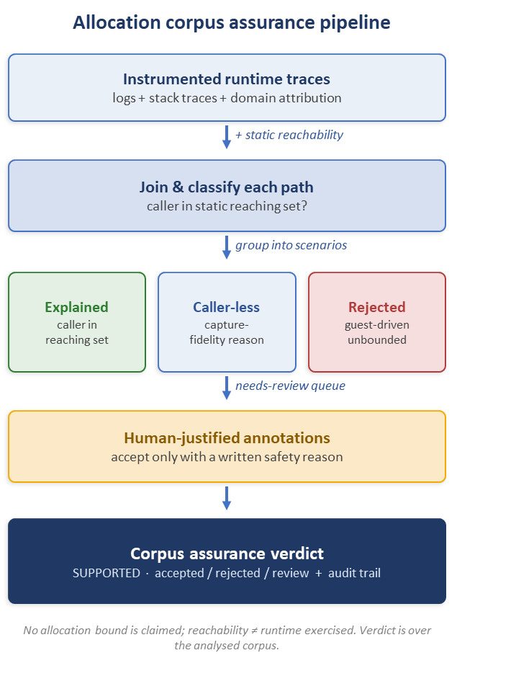
From logs to a corpus assurance
Runtime traces turned into an auditable safety claim
Static reachability join — every runtime allocation is matched against which callers can statically reach its allocator
Canonical scenarios — duplicate stacks collapse into one reviewable scenario each
Cause / effect safety model — accept only if the cause is bounded or the effect is freed before return
Curated annotations — acceptance requires a human justification (never auto-accepted)
Honest residue — caller-less & softirq/RCU paths labelled by capture-fidelity reason, not guessed
Verdict + audit trail — accepted / rejected / needs-review with a reduction report

Slide 29

Going from Out of Context to “In context”
**
DO-178C certification is within the context of a system**. It consists of objectives which are met by completing activities (possibly with independence) to produce specific artifacts. This complements FUSA efforts as follows.
More stringent system failure target - Catastrophic failure** conditions (driving SWL-A) require ≤1E-9 per flight hour vs ASIL-D ≤1E-8 per hour
Deeper verification rigor - Strengthens the certification evidence
Evergreen-friendly - Supports continuous upstream development; certification artifacts remain maintainable as the codebase evolves
**system-level concern from ARP 4754A/4761 drives this and sets the SWL

Slide 30
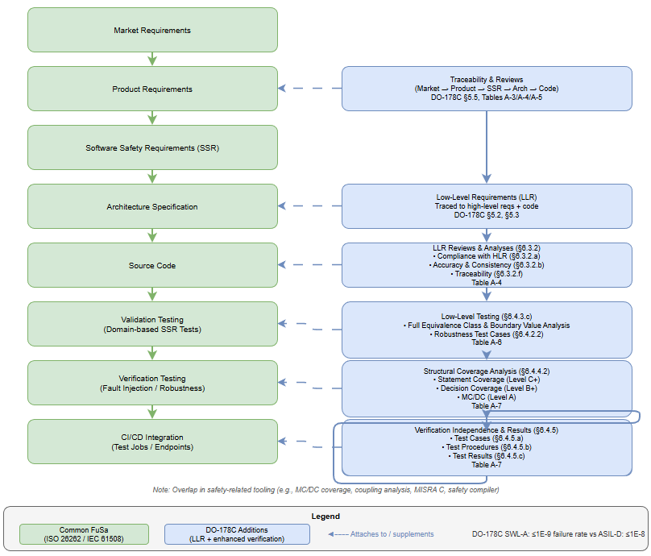
Additions to the FuSa Software Lifecycle
Notes:
Diagrams are all pushed to - https://github.com/elisa-tech/wg-aerospace/pull/177/changes

Slide 31

Additions to the FuSa Software Lifecycle: Low Level Requirements
https://gitlab.com/xen-project/fusa/requirements/-/tree/master/design_reqs/domain_creation_and_runtime/physical_resources/arm64/mmu/pt
Notes:
Diagrams are all pushed to - https://github.com/elisa-tech/wg-aerospace/pull/177/changes

Slide 32

Additions to the FuSa Software Lifecycle: Unit Testing of LLRs for Coverage
https://gitlab.com/xen-project/fusa/test_specifications/-/blob/master/domain_creation_and_runtime/physical_resources/arm64/mmu/pt/pt.tc.md
Notes:
Diagrams are all pushed to - https://github.com/elisa-tech/wg-aerospace/pull/177/changes

Slide 33
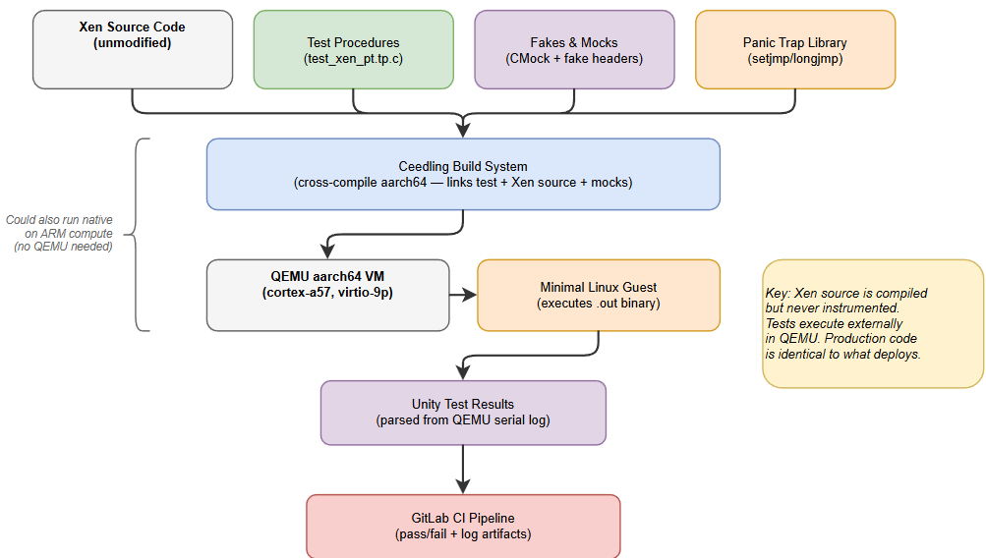

Unit testing(whitebox) of Xen Page Table
Goals:
Automated regression signals - Coverage and CI results provide early indicators of impactful changes
Non-intrusive testing - Validates and measures coverage without modifying production code, keeping the software under test identical to what deploys
Massive Scale - Supports thousands of low level tests, fails fast, and minimizes required compute time
https://gitlab.com/xen-project/fusa/xen-integration/-/merge_requests/20
Notes:
Diagrams are all pushed to - https://github.com/elisa-tech/wg-aerospace/pull/177/changes

Slide 34
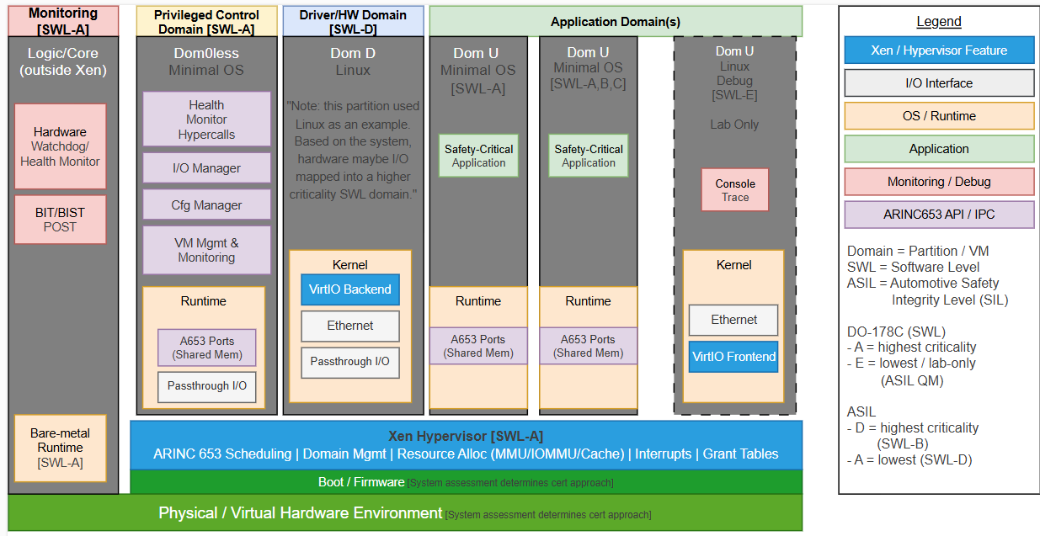
Example: DO-178C Mixed Criticality
System
(DO-178C Sec. 2.3) “only partitioned (time&space) software components can be assigned individual SWL by the system safety assessment Process.“
(DO-178C Sec. 2.4) “if partitioning and independence between software components cannot be demonstrated, all components are assigned the SWL associated with the most severe failure condition to which the software can contribute”
Diagram from: ELISA Aerospace WG discussions on mixed criticality - https://github.com/elisa-tech/wg-aerospace/pull/177
Notes:
Diagrams are all pushed to - https://github.com/elisa-tech/wg-aerospace/pull/177/changes

Slide 35
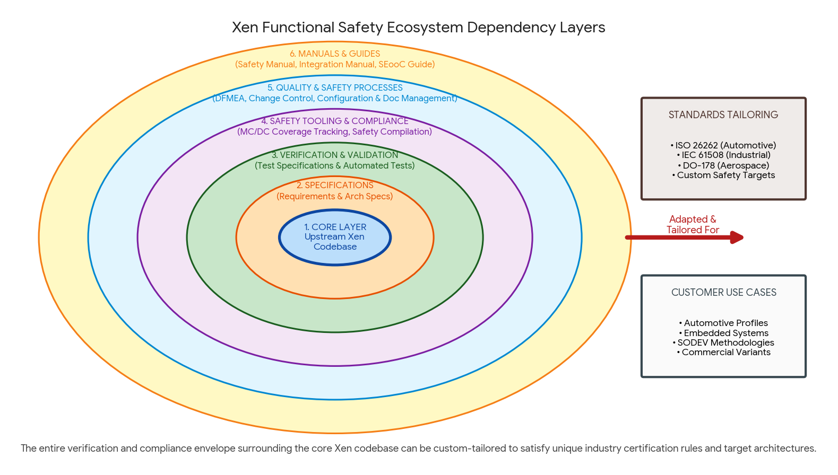
Adding and Maintaining evergreen certification artifacts
Launching a new Xen Project membership Tier for Safety
Defining the Quality Management processes & maintainability
Lightweight QMS process
Approach: reStructuredText git-based docs-as-code
OpenFasttrace as external traceability engine
Sphinx for auditable living documentation rendering
Mapping existing Xen community processes to standards
Use lightweight ISO/IEC 12207 for supporting processes
FuSa SIG implements limited & tailiored safety processes
Notes:
Process related documents, introduce QMS Definition of QMS, versioning, AI based rules, openfastrace rules,

Slide 36

Collaboration
To develop an open source, upstream safe hypervisor requires a lot of community effort
Join xen-devel mailing list – All discussion. Reviews happen on the mailing list
Join Xen Functional Safety matrix channel
Calls every other Tuesday for members actively working on Xen FuSa

Slide 37
Thanks

Slide 38
Backup slides

Slide 39
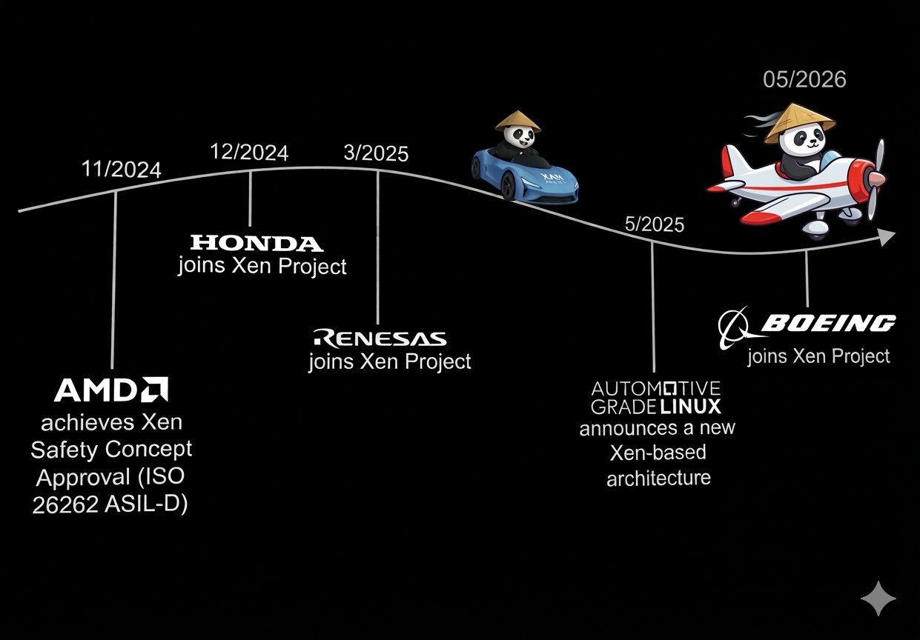
Call for collaboration

Slide 40
Let’s plug Xen in SODEV, etc
Do the minimal isolation with the features
Get audience involved in Xen FuSa
Concerns — Avoid fork
Quality metrics , integrate into safety system, call to action (last slide)
Join xen-devel
Join FuSa meeting

Slide 41
Conclusion

Slide 42
Keeping safety cert evergreen (Loud thinking)
Upstreaming requirements, arch specs and tests
Onboarding new maintainers for the safety artifacts
Code maintainers should not be overburdened
Keeping the code as pristine as possible
Lightweight QMS process
Approach: reStructuredText git-based docs-as-code
OpenFasttrace as external traceability engine
Sphinx for auditable living documentation rendering
Mapping existing Xen community processes to standards
Use lightweight ISO/IEC 12207 for supporting processes
FuSa SIG implements limited & tailiored safety processes
Join us at Xen summit where we align our safety efforts with the wider Xen community
Fusa
Reqs
Arch specs
Tests
Upstream Xen.git
Xen FuSa
(staging repo)
To help with upstreaming and show the FuSa dependencies

Slide 43
Thanks and Questions. (15 mins)

Slide 44
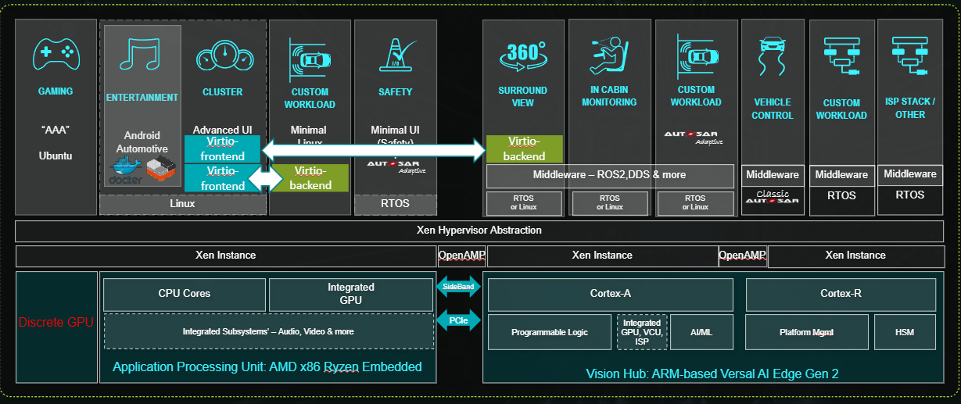


Using Xen as a Unified Runtime Manager
GAMING
“AAA”
Ubuntu
CLUSTER
Advanced UI
CUSTOM
WORKLOAD
Minimal
Linux
SAFETY
Minimal UI
(Safety)
+
SURROUND VIEW
IN CABIN
MONITORING
CUSTOM WORKLOAD
VEHICLE CONTROL
CUSTOM WORKLOAD
ISP STACK / OTHER
ENTERTAINMENT
Android Automotive
Virtio-frontend
Virtio-backend
Adaptive
Virtio-frontend
Virtio-backend
Adaptive
Middleware – ROS2,DDS & more
Middleware
Middleware
Classic
RTOS
RTOS
Middleware
Linux
RTOS
RTOS
or Linux
RTOS
or Linux
RTOS
or Linux
Xen Hypervisor Abstraction
Xen Instance
OpenAMP
Xen Instance
OpenAMP
Xen Instance
Discrete GPU
Application Processing Unit: AMD x86 Ryzen Embedded
SideBand
Vision Hub: ARM-based Versal AI Edge Gen 2
CPU Cores
Integrated
GPU
Cortex-A
Cortex-R
Integrated Subsystems’ – Audio, Video & more
PCIe
Programmable Logic
Integrated
GPU, VCU, ISP
AI/ML
Platform Mgmt
HSM
A Common Hypervisor Layer across Clusters

Slide 45
Civil aviation has standardized computing
“Guidelines for Development of Civil Aircraft and Systems” ARP4754 - addressing "the system" - https://en.wikipedia.org/wiki/ARP4754
“Software Considerations in Airborne Systems and Equipment Certification” DO-178C - software-based aerospace systems - https://en.wikipedia.org/wiki/DO-178C
“Avionics Application Software Standard Interface“ https://en.wikipedia.org/wiki/ARINC_653 for the operating environment. See “ARINC 653 hypervisor” ref on the linked page for details.)
“Integrated Modular Avionics(IMA)” DO-297 - System level guidance for mixed safety-criticality - https://en.wikipedia.org/wiki/DO-297
“Use of Multi-Core Processors” AC 20-193 - https://www.faa.gov/documentLibrary/media/Advisory_Circular/AC_20-193.pdf
Standardized safety computing I/O and peripherals - https://en.wikipedia.org/wiki/ARINC#Standards

Slide 46
Ayan to do
URLs to xen-devel, xen-project, QR code on each slide
Linux/Zephyr collaboration
Grammer, fonts, diagrams check

Slide 47
Additional slides

Slide 48
Non blocking virtIO
Traditionally
The regular domain is blocked until the hardware domain returns a response.
Control domain - Zephyr
Hardware domain – VirtIO backend
Targetable regular domain – VirtIO frontend
Non blocking virtIO allows the communication to be asynchronous
Device emulation using Qemu
IO request to the backkend
Safety certified Xen – ASIL D / SIL3
Forwards the

Slide 49
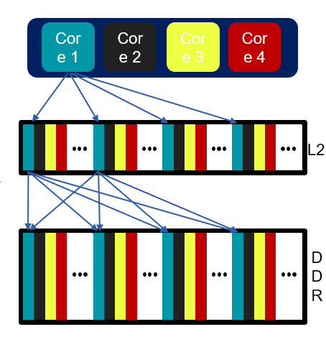
Real Time - Cache coloring
CPUs clusters often share L2 cache
Interference via L2 cache affects performance
App0 running on CPU0 can cause cache entries evictions, which affect App1 running on CPU1
App1 running on CPU1 could miss a deadline due to App0’s behavior
It can happen between Apps running on the same OS & between VMs on the same hypervisor
Hypervisor Solution: Cache Partitioning, AKA Cache Coloring
Each VM gets its own allocation of cache entries
No shared cache entries between VMs
Allows real-time apps to run with deterministic IRQ latency

Slide 50
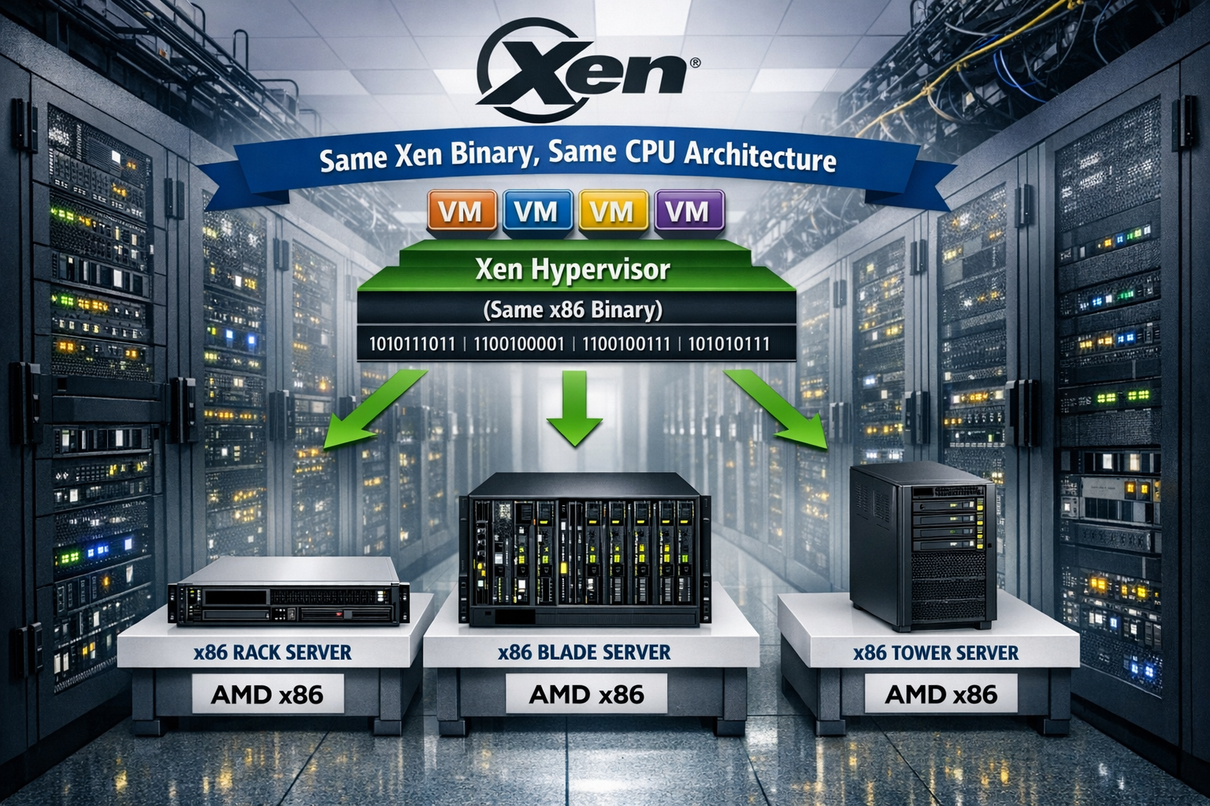
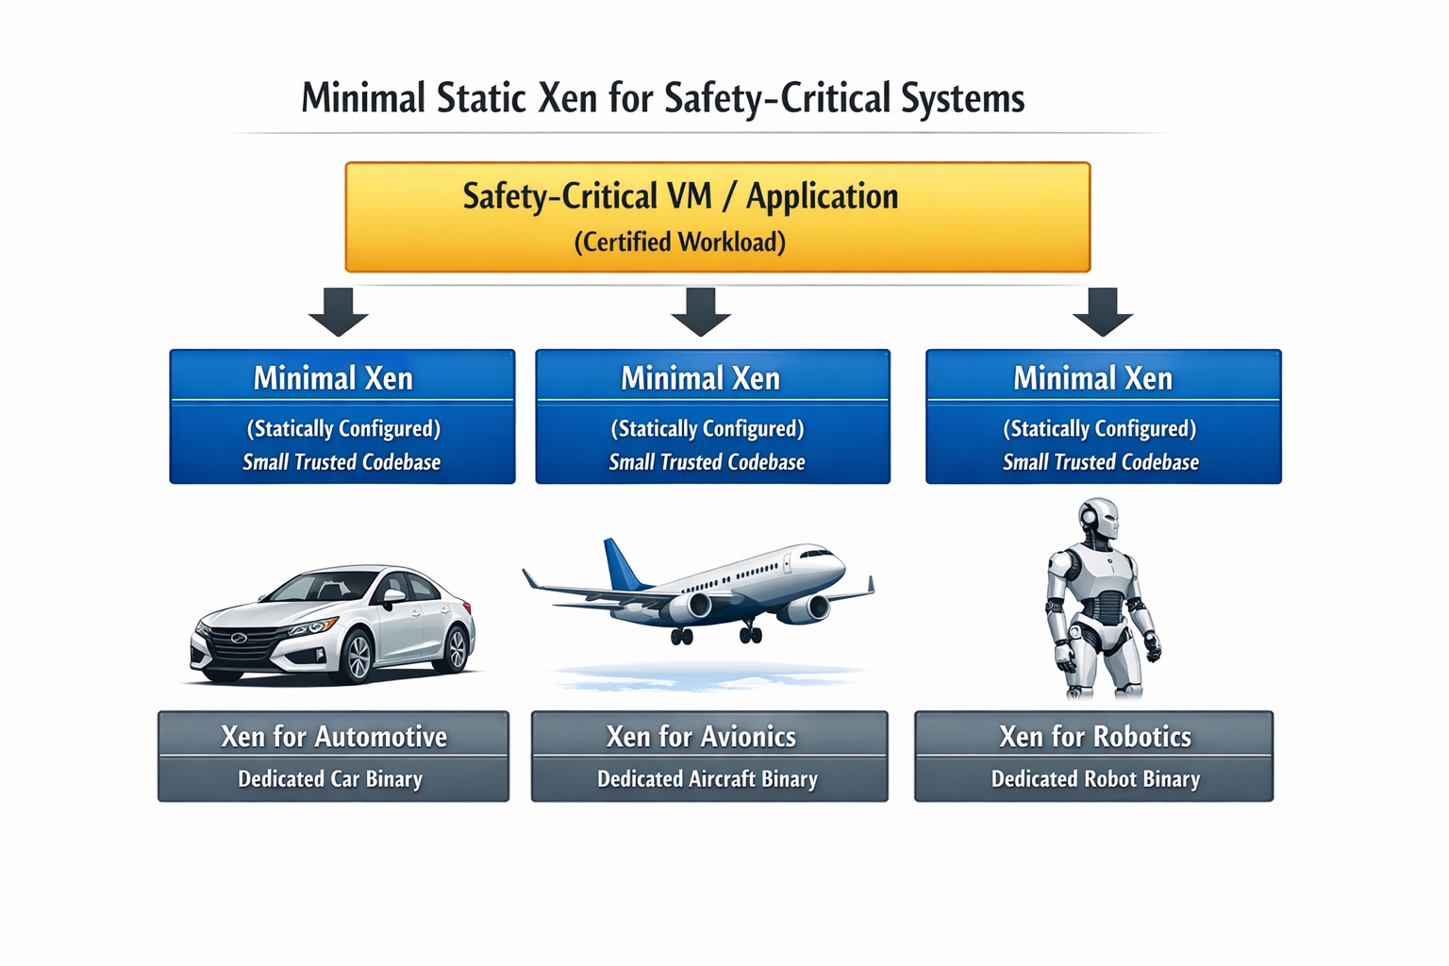
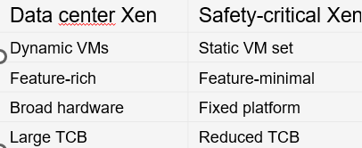
Fine Granular configs to reduce SLoC
Add configs to eliminate code related to unsupported hardware features
GICv3 NR_LRS
GICv3 Num of priorities
https://patchew.org/Xen/20260318140900.3795710-1-ayan.kumar.halder@amd.com/
Notes:
Move to the conclusion after QnA

Slide 51
Fuzzing testing: LibAFL + QEMU​
QEMU provides "snapshot" feature which allows us tighten main loop, as no reboots are needed:​
​Spawn QEMU​
Boot SUT (Xen + XTF test harness in our case)​
Test harness requests test input. At this point snapshot is created​
Fuzzer provides input to the test harness​
Input is passed to Xen. Code coverage is measured​
Test harness submits test result (fail/no fail) + code coverage data to the fuzzer​
Fuzzer prepares new input ​using structured mutation
restore snapshot
Test harness uses:
Domain-based testing
HW/SW interface testing
Internal interface testing
Fault injection

Slide 52
Structured fuzzing​
The simplest type of input is homogenous byte buffer without internal structure. We hope that fuzzer will determine structure by itself. Works surprisingly well (we even found some crashes using this technique)​
Structured fuzzing: fuzzer is aware of internal structure of a request, which allows it to submit more valid requests and mutate them in a meaningful way:​
struct evtchn_bind_interdomain {
/* IN parameters. */
domid_t remote_dom;
evtchn_port_t remote_port;
/* OUT parameters. */
evtchn_port_t local_port;
};
For example, fuzzer can target specifically "remote_dom" field and use special values like DOMID_SELF​

Slide 53
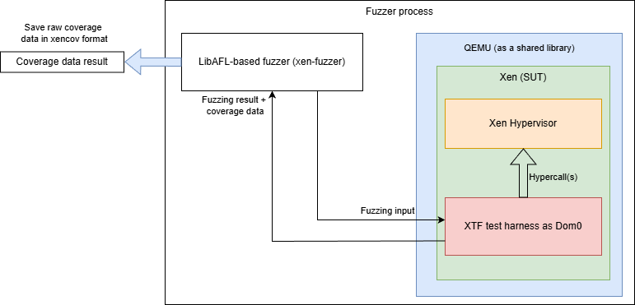
Coverage​
LibAFL can collect coverage data on machine instruction level using QEMUs own JIT translator (TCG). ​
But we use Xen's own coverage collection mechanism "xencov", both as fuzzer feedback and as metrics to evaluate fuzzing session.​

Slide 54
External MC/DC collection workflow
Analyze AST to find decisions and conditions, collect expression structure, variable names, code locations
Combine this data with DWARF information to identify binary code ranges that correspond to boolean expressions
Disassemble binary code and match it to structure of boolean expressions of interest
Use data from the previous step to generate list of PC locations (and corresponding auxiliary data) for QEMU plugin
QEMU plugin traces code execution, uses auxiliary data to determine result of each condition and provides tracing output
Separate tool analyzes trace to provide MC/DC report

Slide 55
Implementation nuances
Caveats
Pros
Requires binary to be built without any optimizations (-O0)
Will depend on compiler (we are focusing on Arm Compiler for Embedded, which is based on clang 22.1)
Cannot easily handle complex macros (TBH, GCC's own analyzer struggles with this as well)
Does not require code modification (except enabling compilation with -O0)
Should provide better results than LLVM's own MC/DC analyzer
Execution is traced externally: Software Under Test can't inadvertently alter counters due to subtle defects
Execution is traced externally: tracing data will be present even if SUT crashes

Slide 56
Binary code matching
Thanks to -O0, clang generates very predictable binary code structure:
Thanks to DWARF we can match variables (and cross-check code locations)
ac4: 385ef3a8 ldurb w8, [x29, #-17]
ac8: 37000148 tbnz w8, #0, af0 <main+0x38c>
acc: 14000001 b ad0 <main+0x36c>
ad0: 385ee3a8 ldurb w8, [x29, #-18]
ad4: 370000e8 tbnz w8, #0, af0 <main+0x38c>
ad8: 14000001 b adc <main+0x378>
Load variable ( 'a' from the previous slide)
Perform op + short circuit ( !a && ...)
Go to next sub-expression
Load variable ( 'b' from the previous slide example)
Perform op + short circuit ( !b && ...)
Go to next sub-expression
0x000001cc: DW_TAG_variable
DW_AT_location (DW_OP_fbreg -17)
DW_AT_name ("a")
DW_AT_decl_file ("test2.c")
DW_AT_decl_line (13)
DW_AT_type (0x00000228 "_Bool")
<= matches [x29, #-17] from disassembly
<= variable name

Slide 58
Market Requirements
Identify the scope of the safety certification for Xen
Defines the expectations of Xen for automotive and embedded use cases
So, this is mostly of interest to the product marketing or FAE who have expectations from a hypervisor.
Written with a high-level view of the system
Example:
Name | Description
Static VM definition | Xen shall specify the resources required to boot and run safe and non-safe VMs.
Run Arm64 and AMD-x86 VMs | Xen shall run Arm64 and AMD x86 VMs.
VM device assignment | Xen shall assign devices to each VM. For e.g.: it should be able to assign GPU to VM1, MMC to VM2. Only the VM assigned to a device shall have exclusive access to the device.

Slide 59
Product Requirements
Product Requirements explain how Market Requirements are fulfilled by Xen
Product Requirements are Xen specific
So, this of interest to Xen architects who understand how the requirements are fulfilled by Xen.
Still written with a high-level view of the system
Product Requirements can sometimes be linked to more than one Market Requirement
Run ARM and AMD x86 VMs
Emulated UART
Xen shall emulate UART on behalf of the domains.
Emulated Timer
Xen shall emulate timer on behalf of domains.

Slide 60
1 Product Requirements 🡪 N Software Safety Requirements
Emulated Timer
Probe the Generic Timer device tree node from a domain
Xen shall generate a device tree node for the Generic Timer (in accordance to ARM architected timer device tree binding [2]) to allow domains to probe it.
Read system counter frequency
Xen shall enable domain to read the frequency of the system counter (either via CNTFRQ_EL0 register or "clock-frequency" device tree property if present).
Access virtual timer from a domain
Xen shall enable domain to access and make use of the virtual timer by accessing the following system registers: CNTVCT_EL0, CNTV_CTL_EL0, CNTV_CVAL_EL0, CNTV_TVAL_EL0.
Trigger the physical timer interrupt from a domain
Xen shall enable domain to program the physical timer to generate the interrupt when the asserted condition is met.
Trigger the virtual timer interrupt from a domain
Xen shall enable domain to program the virtual timer to generate the interrupt when the asserted condition is met.

Slide 61
Characteristics of Software Safety Requirements
The requirements are written in plain English, from the perspective of what Xen is expected to fulfil
The software safety requirements (SSR) are expected to be the most granular form
Engineers are expected to refer to a SSR (and architecture spec) to write a test to validate it
This is of interest to the subsystem maintainers or folks working on specific parts of Xen (eg generic timer).
Each SSR should be tested independently
SSR should be unambiguous, complete, consistent, correct
SSR should be traceable all the way to market requirements

Slide 62
Work in Progress - License: CC-BY-4.0

Slide 63
Work in Progress - License: CC-BY-4.0

Slide 64
Work in Progress - License: CC-BY-4.0

Slide 65
The missing puzzle
Space and time partitioning
Defining a FuSa system use case
EL1 stage 2 (P2M) for VM1
EL1 stage 2 (P2M) for VM2
EL1 stage 2 (P2M) for VM3
QM VM
Safe VM
Mixed VM
Testing for isolation between the VMs partitioning in Xen
Time slot
Time slot
Time slot
FuSa XEN
FuSa Xen (SIL-3/ASIL-D/mixed)
EL2 mapping for Xen
FuSa Firmware/bootloader
FuSa hardware
Stay tuned to see how DO-178 addresses these challenges

Slide 66
Licensing of Workshop Results
All work created during the workshop is licensed under Creative Commons Attribution 4.0 International (CC-BY-4.0) [https://creativecommons.org/licenses/by/4.0/] by default, or under another suitable open-source license, e.g., GPL-2.0 for kernel code contributions.
You are free to:
Share — copy and redistribute the material in any medium or format
Adapt — remix, transform, and build upon the material for any purpose, even commercially.
The licensor cannot revoke these freedoms as long as you follow the license terms.
Under the following terms:
Attribution — You must give appropriate credit, provide a link to the license, and indicate if changes were made. You may do so in any reasonable manner, but not in any way that suggests the licensor endorses you or your use.
No additional restrictions — You may not apply legal terms or technological measures that legally restrict others from doing anything the license permits.
Work in Progress - License: CC-BY-4.0

Slide 68
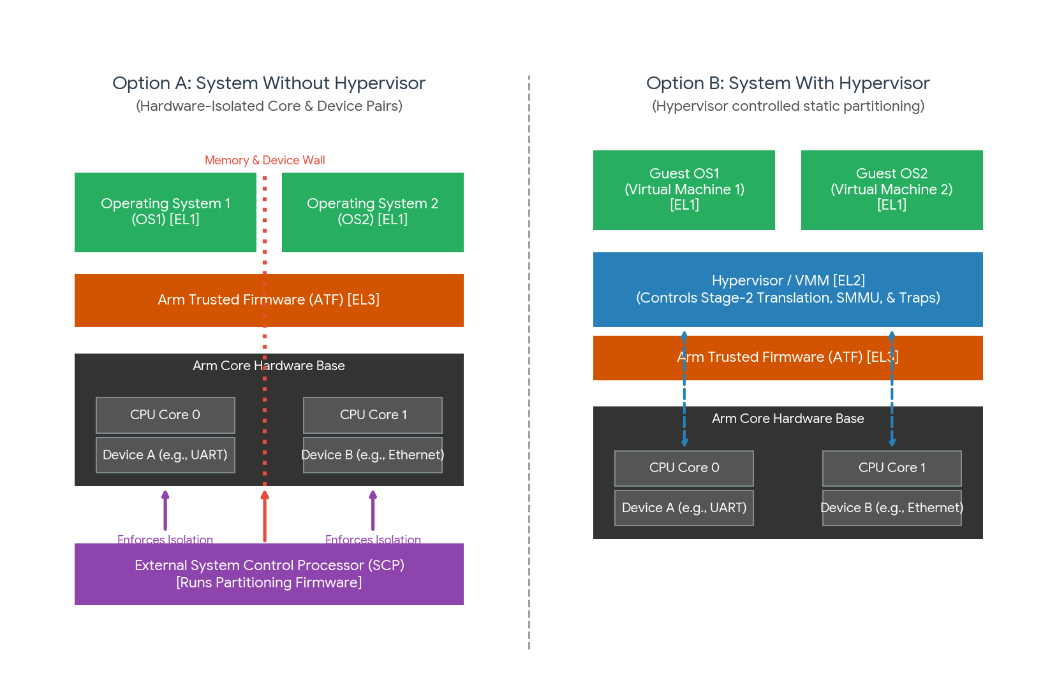
Why do we need a hypervisor in safety critical system
Notes:
Mention about the AoU about the SoC/firmware for partitioning system, performance, mixed levels of safety (for VMs)

Slide 69
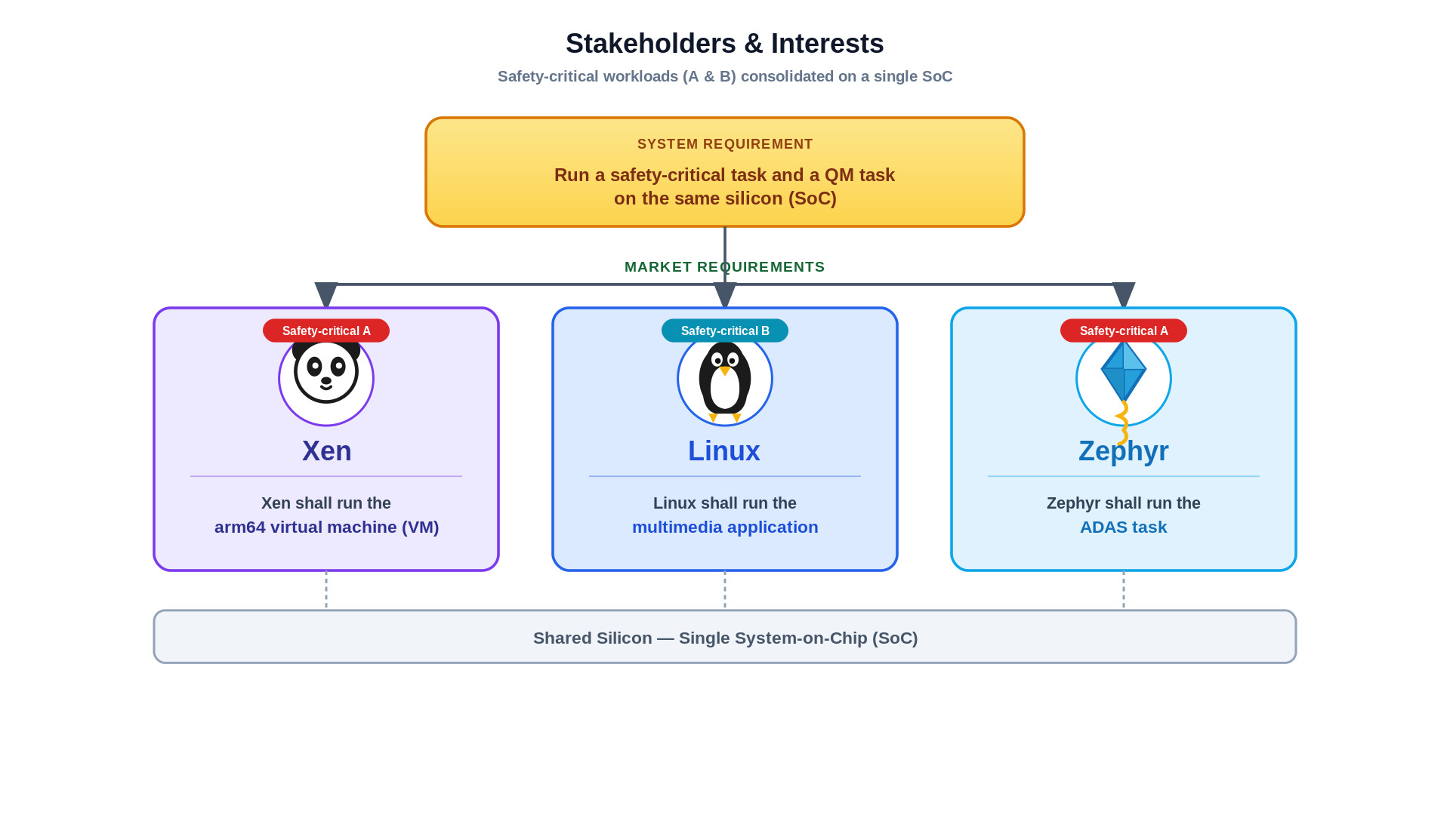
How the different stakeholders take a part
Notes:
Not use A, B – only use the color tags, slide 18 is the talking point for slide 19

